Slide 1
Weekly Report 1
Digital Audio Workstation- Brandon Smith, Alice Bruce, Clayton Sanner

Slide 2
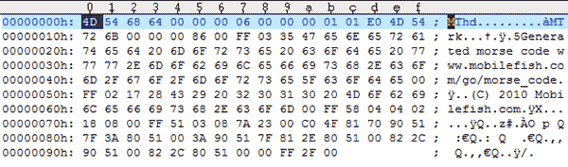
Brandon – Github Repository
Created the Github Repository
First Stage of program Development
How the MIDI file information is handled
Compilation error

Slide 3
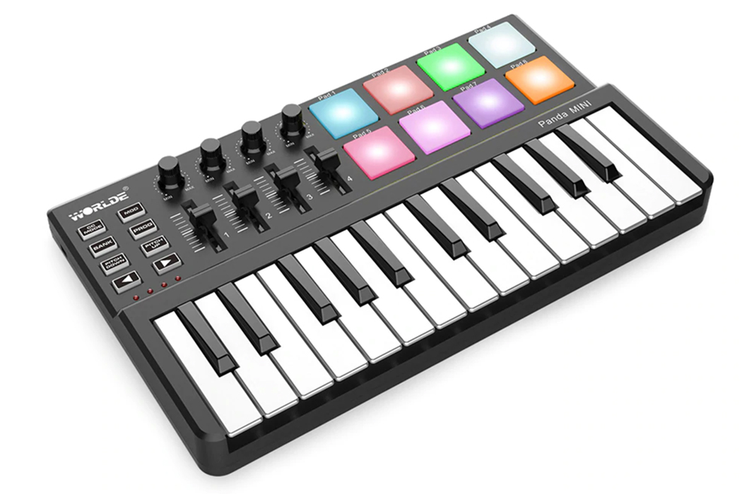
Alice Bruce – Peripheral Libraries
PortMidi
RtMidi
LibreMidi
Pros/Cons of each

Slide 4
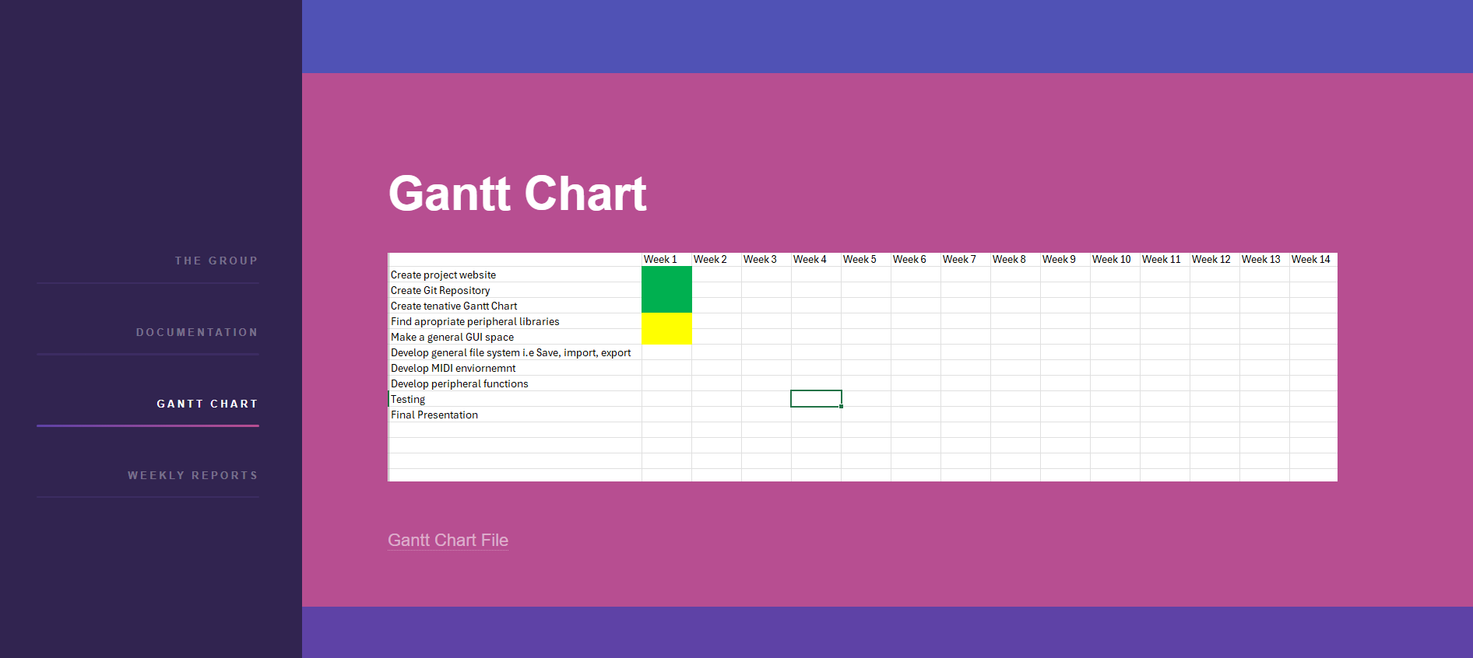
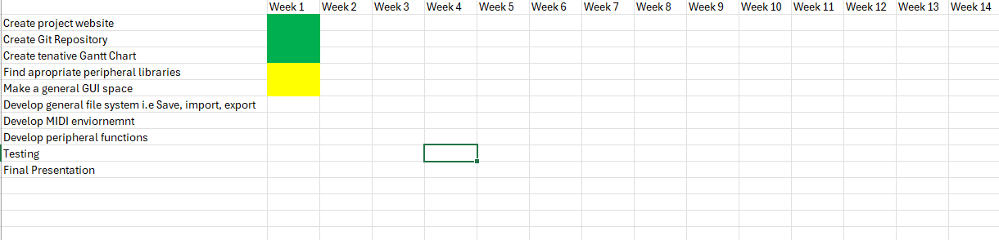
Clayton Sanner – Gantt Chart and Project Website
Github Pages
Html5up template
Documentation
Gantt Chart
https://claytonsanner33.github.io/

Slide 5





Conclusion

